Slide 1

Computer Vision
in
Finance

Slide 2
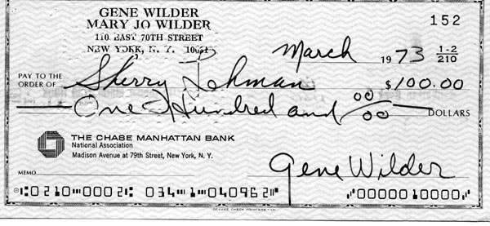
Signature matching

Slide 3
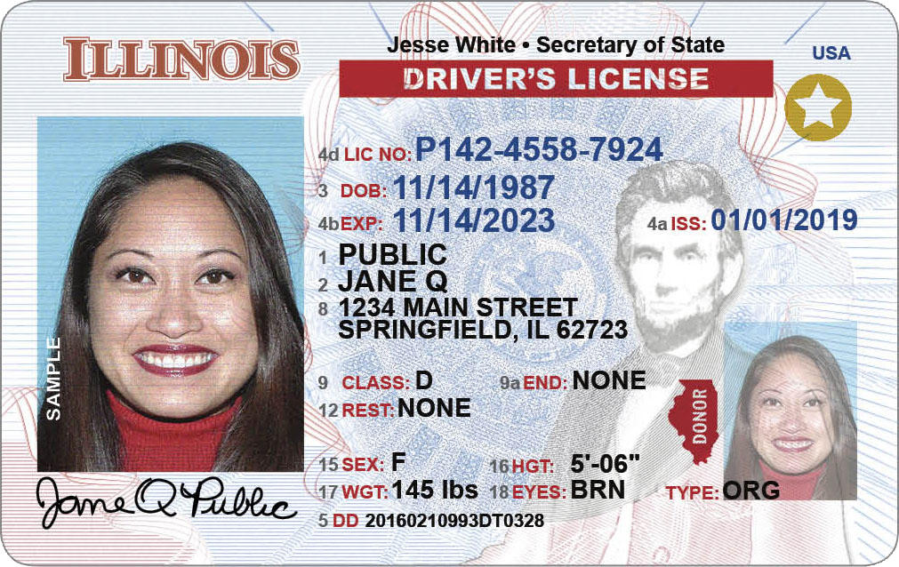
Face Matching

Slide 4
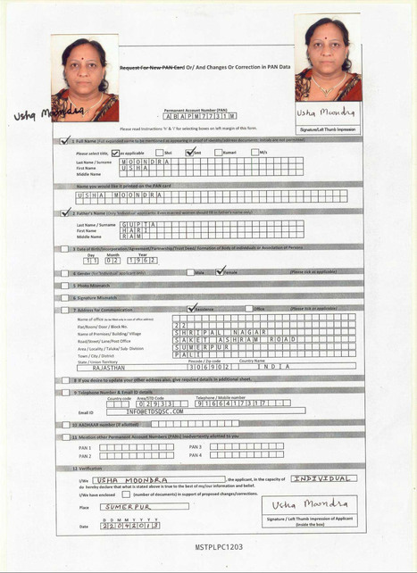
Information Extraction

Slide 5
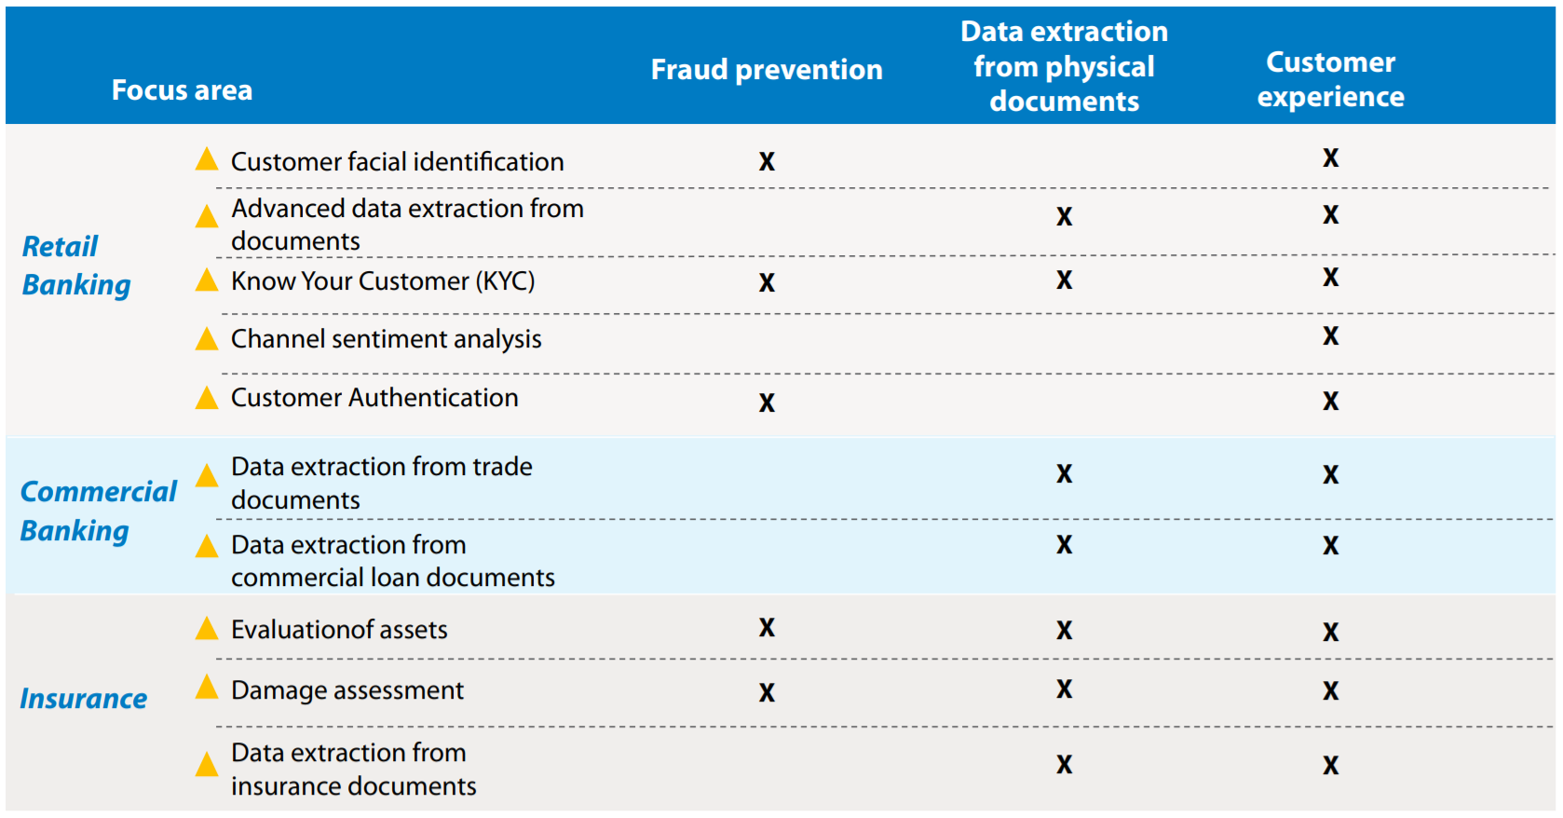
Computer Vision: A Game Changer for Banking, Financial Services and Insurance
https://www.tcs.com/content/dam/tcs/pdf/Industries/Banking%20and%20Financial%20Services/Computer-Vision-in-Banking.pdf

